Slide 1


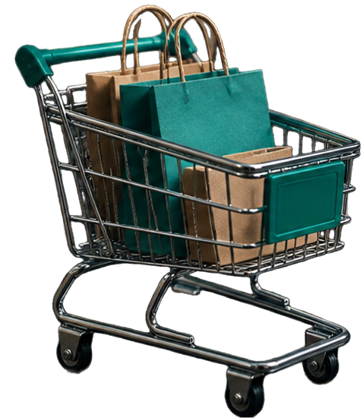
CUSTOMER
SHOPPING
ANALYSIS:
Insights from Data to Strategy
An end-to-end analysis of customer shopping habits and transactional data

Slide 2










PROJECT
OVERVIEW
An end-to-end analysis of customer shopping habits and transactional data to deliver actionable business insights.
CLEAN
MEASURE
VISUALIZE
RECOMMEND
Python data cleaning and exploration
SQL-driven business metrics
Power BI interactive dashboards
Data-driven strategic insights
Bridging data science and business strategy to drive smarter decisions.

Slide 3





DATASET
SUMMARY & QUALITY
3,900
rows, 20 columns
Key attributes
Customer ID, Age, Gender, Item Purchased, Category, Purchase Amount, Location, Season, Review Rating, Subscription Status, Shipping Type, Payment Method
Data quality
Zero missing values in core transactional fields; median imputation applied for missing Review Ratings by product category
AVERAGE PURCHASE AMOUNT
CUSTOMER AGE
AVERAGE REVIEW RATING
$59.76
18–70
3.75/5
range $20-$100
years, mean ~44

Slide 4













EXPLORATORY
DATA ANALYSIS
(PYTHON)
Used pandas for loading, info(), describe(),
and null checks
CLEAN
Imputed missing Review Ratings with
median by product category
IMPUTE
Created age_group bins and
purchase frequency_days metric
ENGINEER
High-volume items: Blouses, Jewelry,
Pants, Shirts, Dresses
Average spend stable around $60 across categories
DISCOVER
Connected cleaned data to MySQL
for further analysis
CONNECT

Slide 5






BUSINESS METRICS
FROM SQL ANALYSIS
Core insights derived from SQL queries and business metrics.
01
Revenue patterns across gender and age groups
02
Discount usage, high spenders and subscription impact
03
Top products and categories
by rating and performance
04
Customer segmentation
and repeat purchase behavior
05
Shipping preferences
and order value comparisons

Slide 6

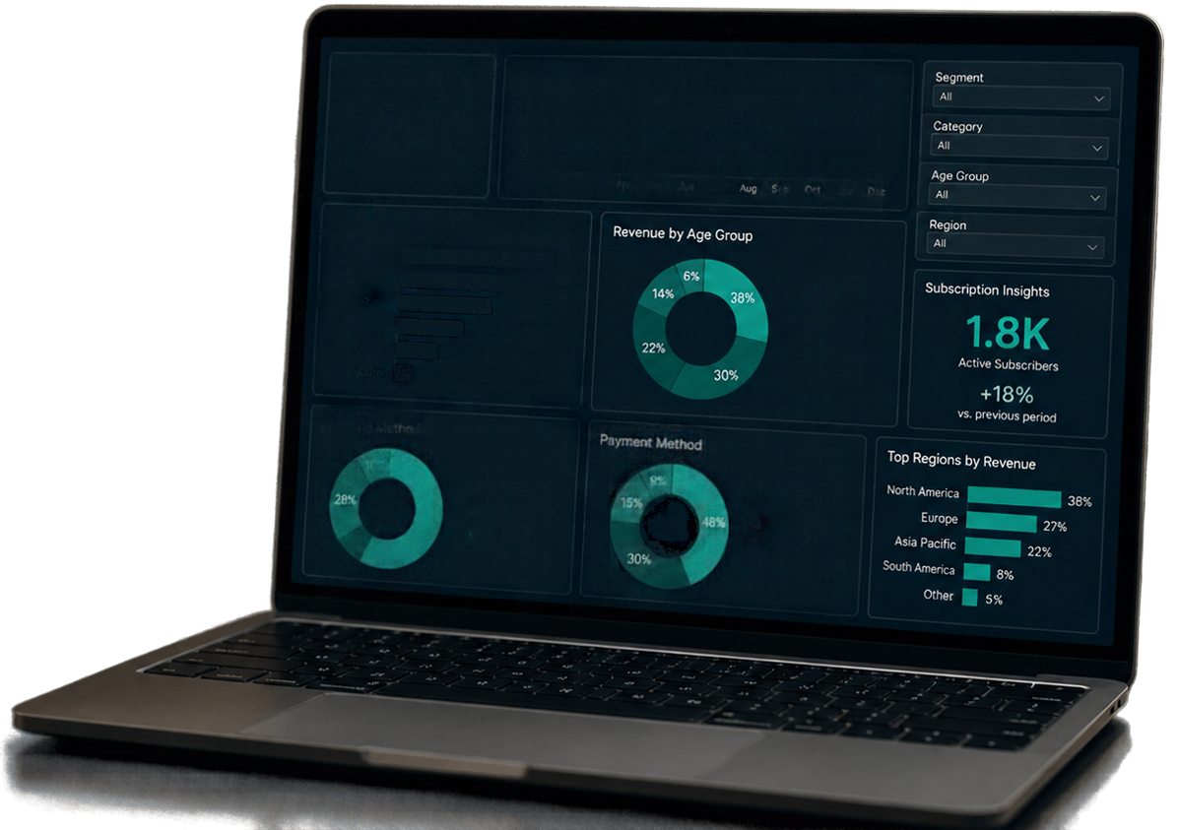








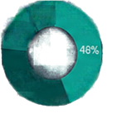
POWER BI
DASHBOARD INSIGHTS
Revenue Overview
Purchase Trend
$2.45M
Total Revenue
Jan
Feb
Mar
Apr
May
Jun
Jul
Sep
Nov
Dec
Revenue by Category
Electronics
Apparel
18–25
Visual and interactive presentation of analysis results.
Home & Kitchen
26–35
Beauty
36–45
36–45
Sports
36–45
45–60
60+
Revenue and purchase trends by demographics and category
60+
Shipping Method
Payment Method
10%
9%
Customer segmentation filters and subscription insights
28%
Standard
18%
Credit Card
82%
Express
Digital Wallet
Overnight
South America
30%
Net Banking
Shipping and payment
method comparisons
Interactivity for dynamic business exploration

Slide 7










STRATEGIC BUSINESS
RECOMMENDATIONS
01
BOOST SUBSCRIPTIONS
Introduce exclusive benefits and loyalty rewards to increase current 27% subscriber base.
02
FOCUS INVENTORY
Prioritize Clothing and Accessories due to their dominant sales contribution.
03
PAYMENT & SHIPPING FLEXIBILITY
Maintain support for PayPal, Credit Card, Cash, Debit, and Venmo to minimize cart abandonment.
04
NEXT STEPS
Implement recommendations and monitor performance to drive continuous improvement.

